Slide 1


Online Mobile Shopping Portal
Presented By –
Zambre Akshay D.
Rajveer Singh Bhamra.

Slide 2
Introduction
Portal a website that is used as a point of entry to the Internet,where information has been collected that will be useful to a person
interested in particular kinds of things.
Online Mobile App Portal is nothing bua a portal which thinks providing
users as the main target and provides services at their home. also it provides so many shopping services along with deliveries only by sitting and using this portal at home.

Slide 3

Objectives
This projects aims to develop an online shopping for customers with the goal so that it is very easy to shop your loved things from a extensive number of online shopping sites available on the web. With the help of this you can carry out an online shopping from your home.
Here is no compelling reason to go to the crowd stores or shopping centers during festival seasons. You simply require a PC or a laptop and one important payment sending option to shop online. To get to this online shopping system all the customers will need to have a email and password to login and proceed your shopping it easily.

Slide 4



Technology Used
Front-End : React Js
Back-End : Spring Boot Api
Database : MySql

Slide 5
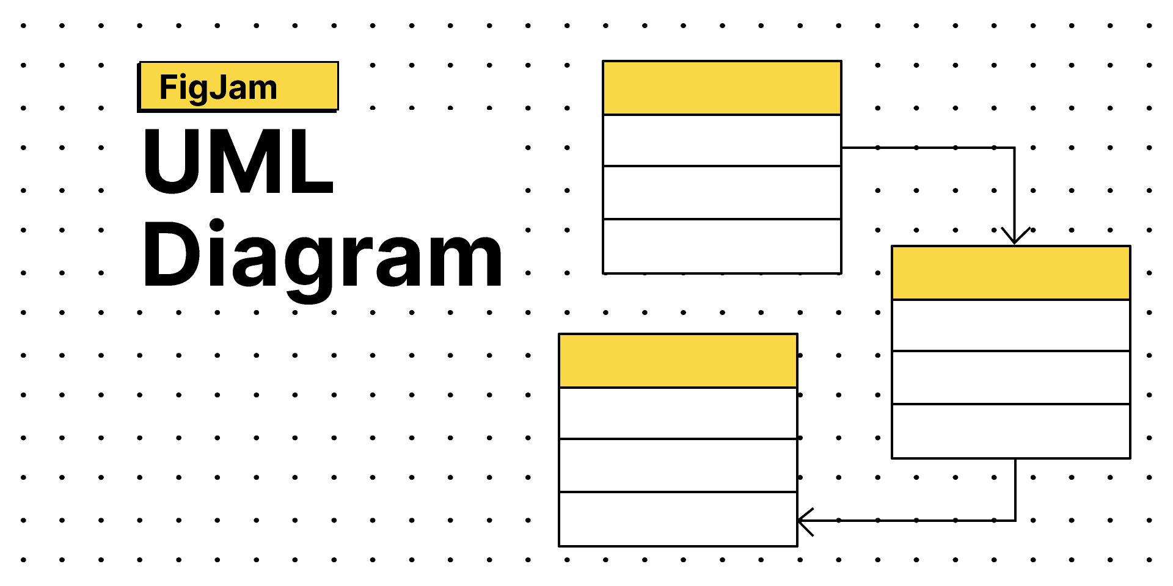
UML Diagrams

Slide 6
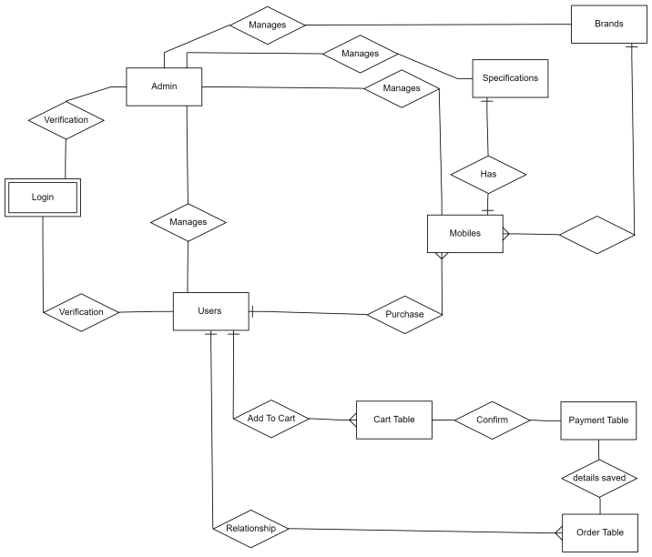
E-R Diagram

Slide 7
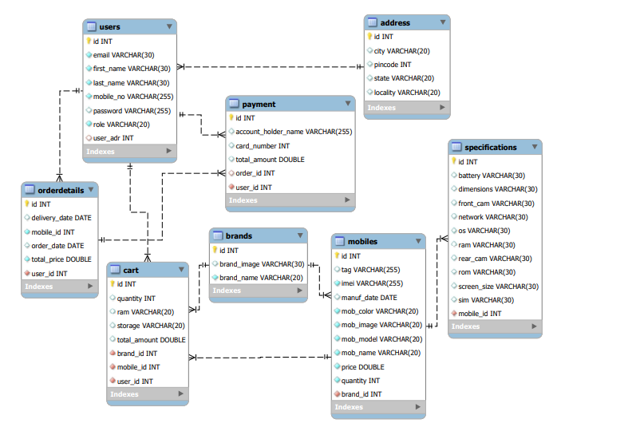
E-R Diagram(MySQL Auto-Generated)

Slide 8
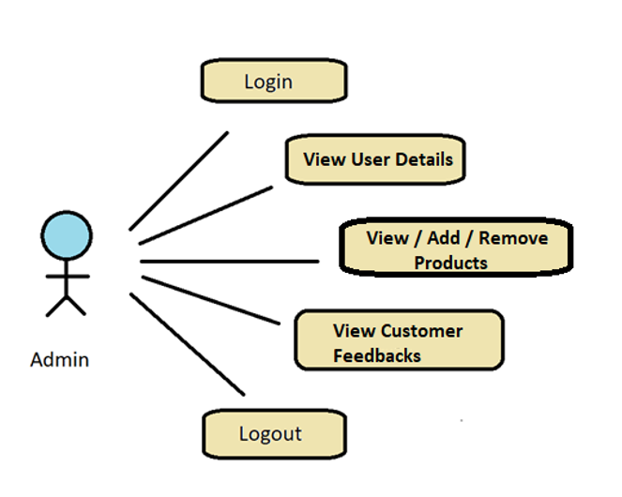
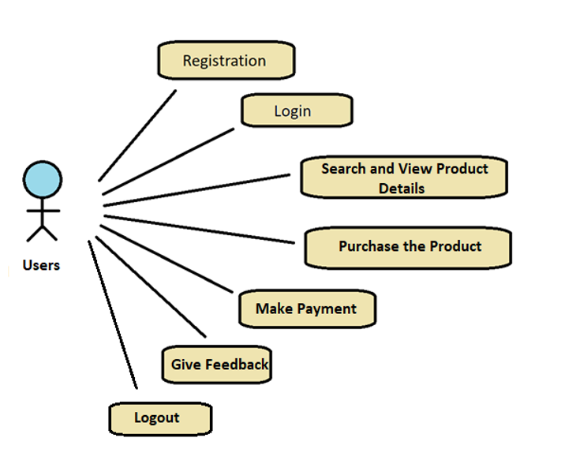
Use Case Diagrams

Slide 9
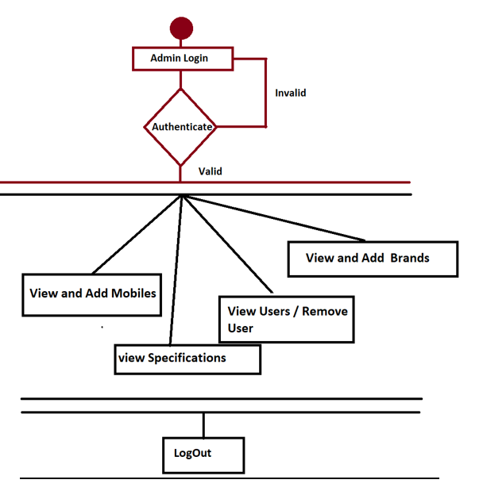
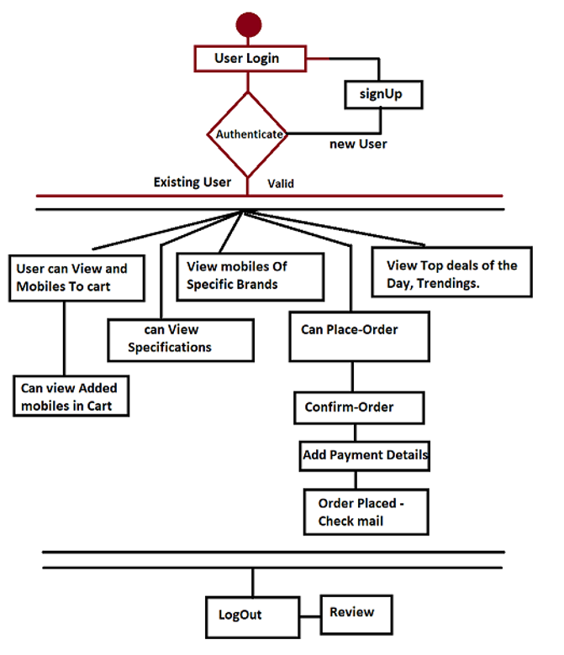
Activity Diagrams

Slide 10
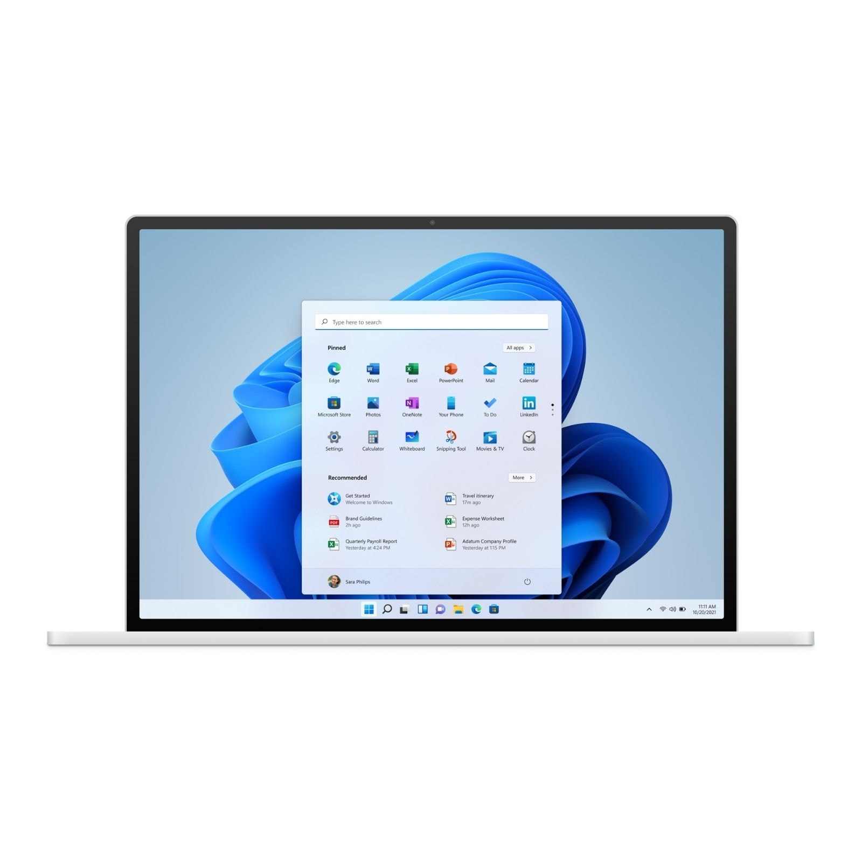

Screen-Shots

Slide 11


Admin-Side

Slide 12
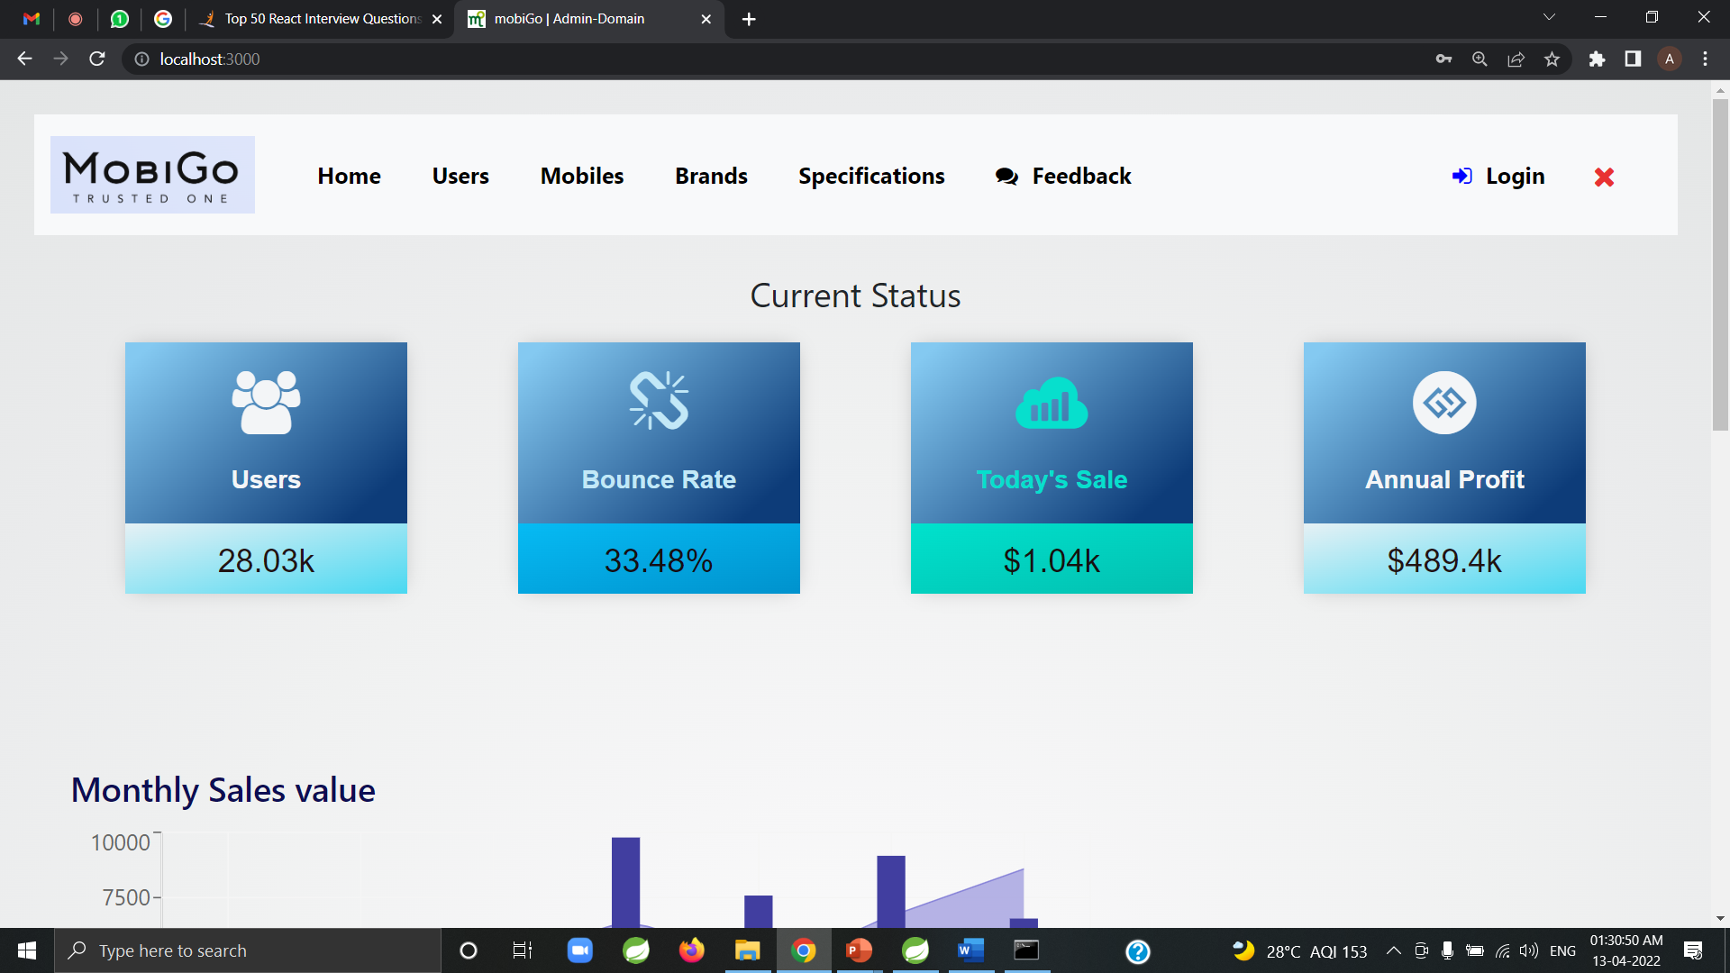

Slide 13
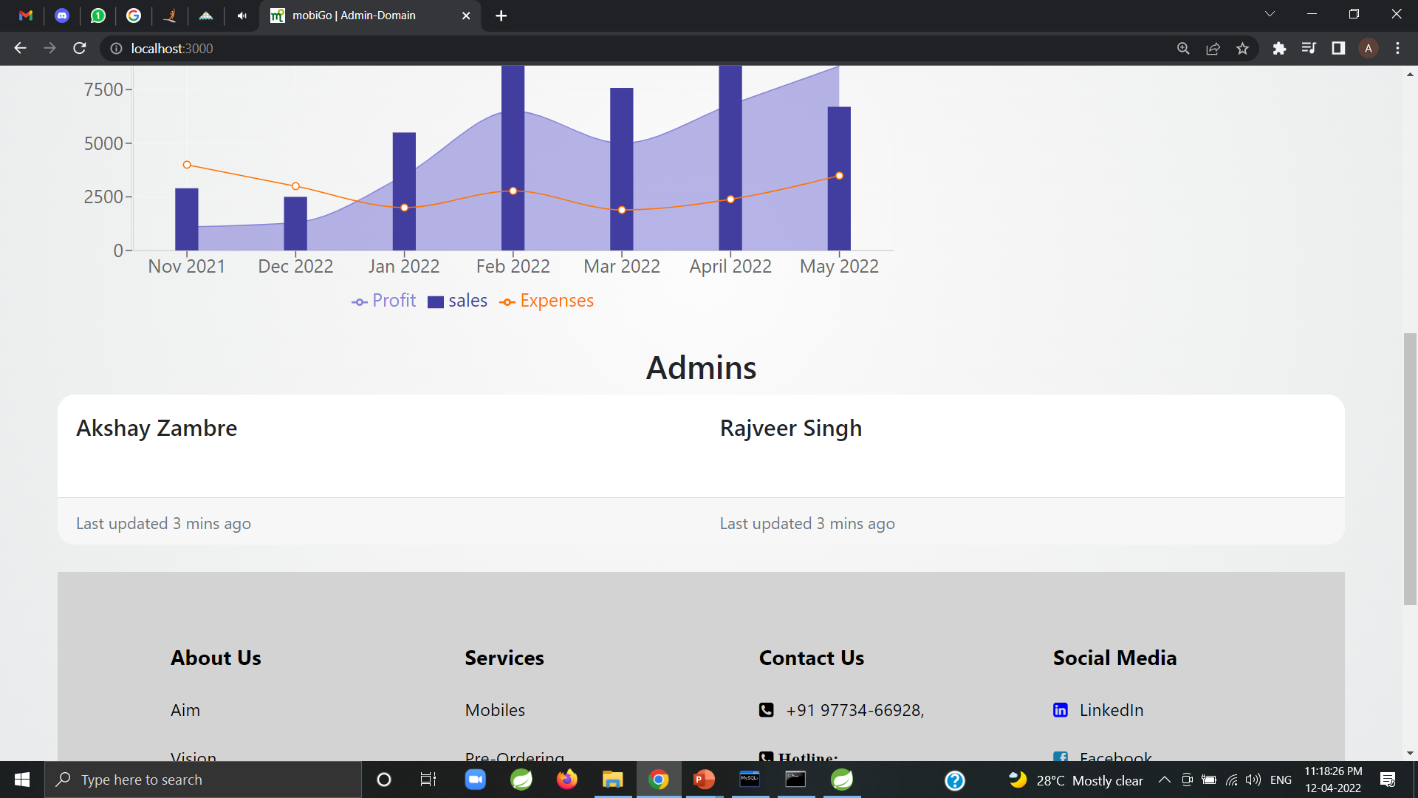

Slide 14
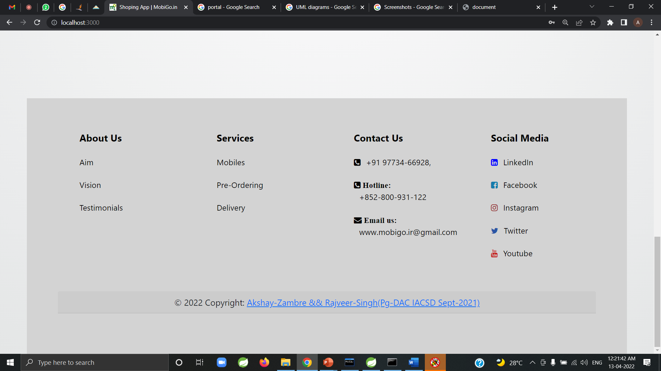

Slide 15
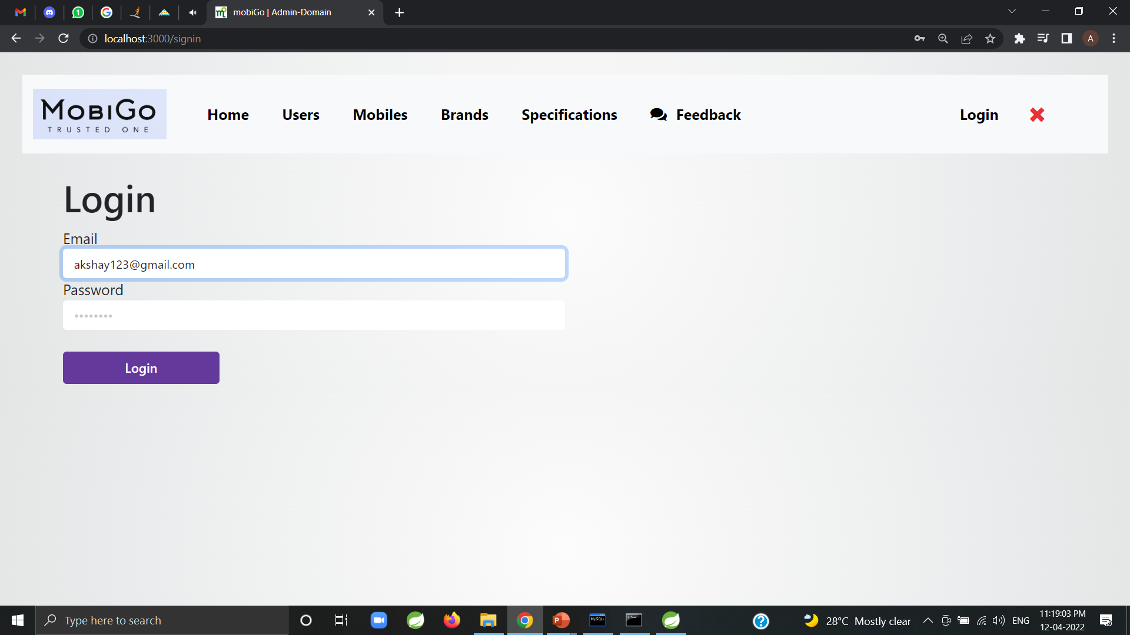
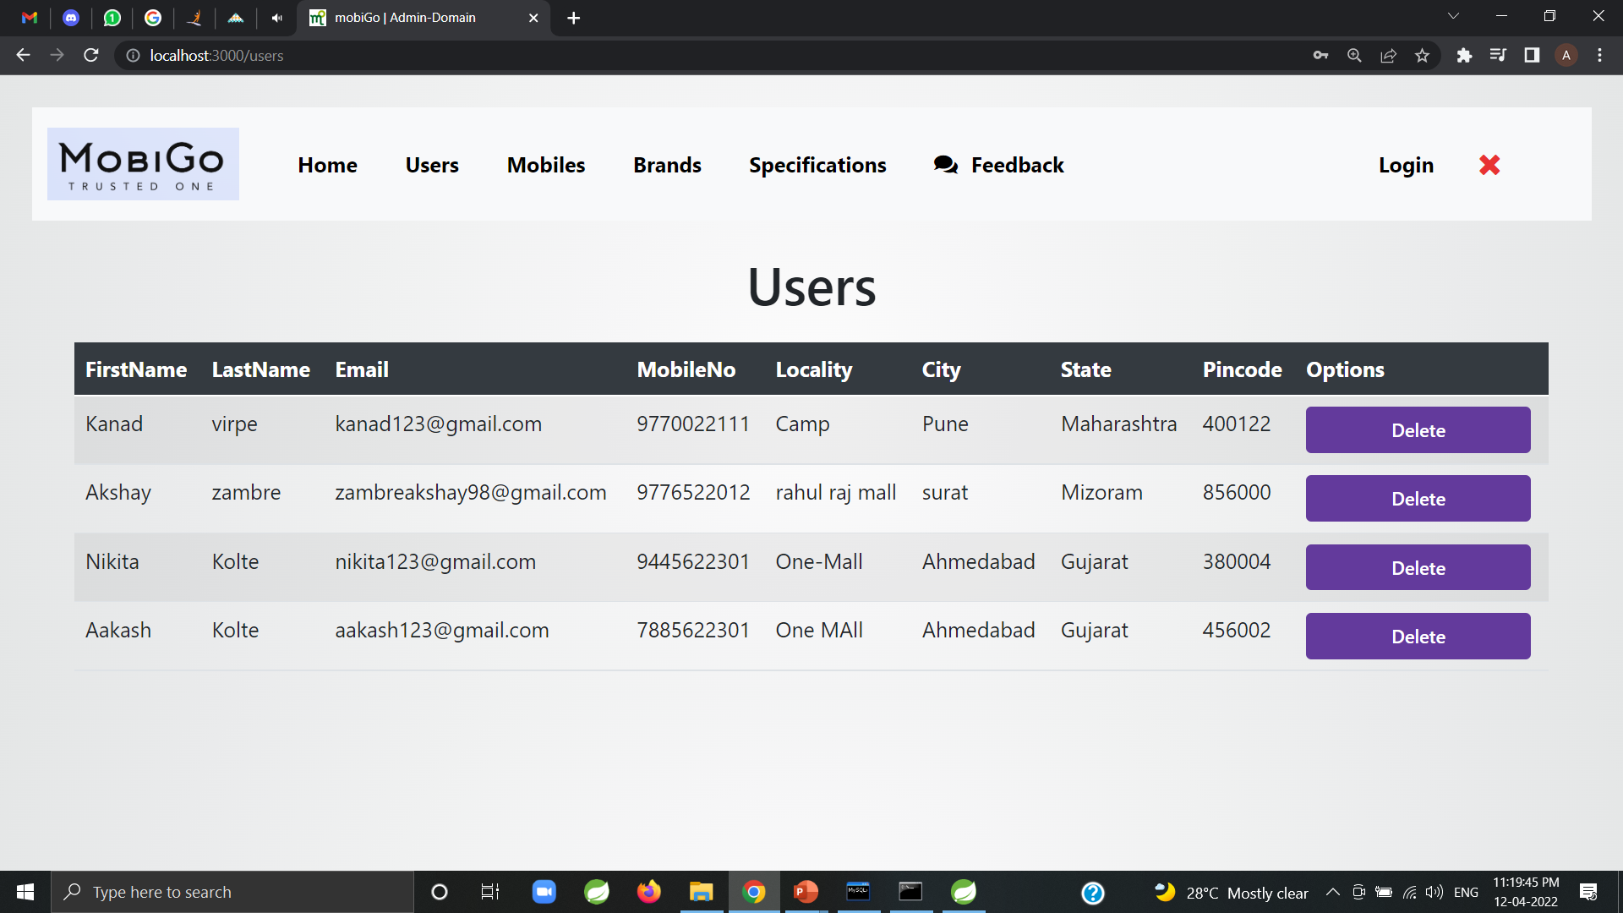
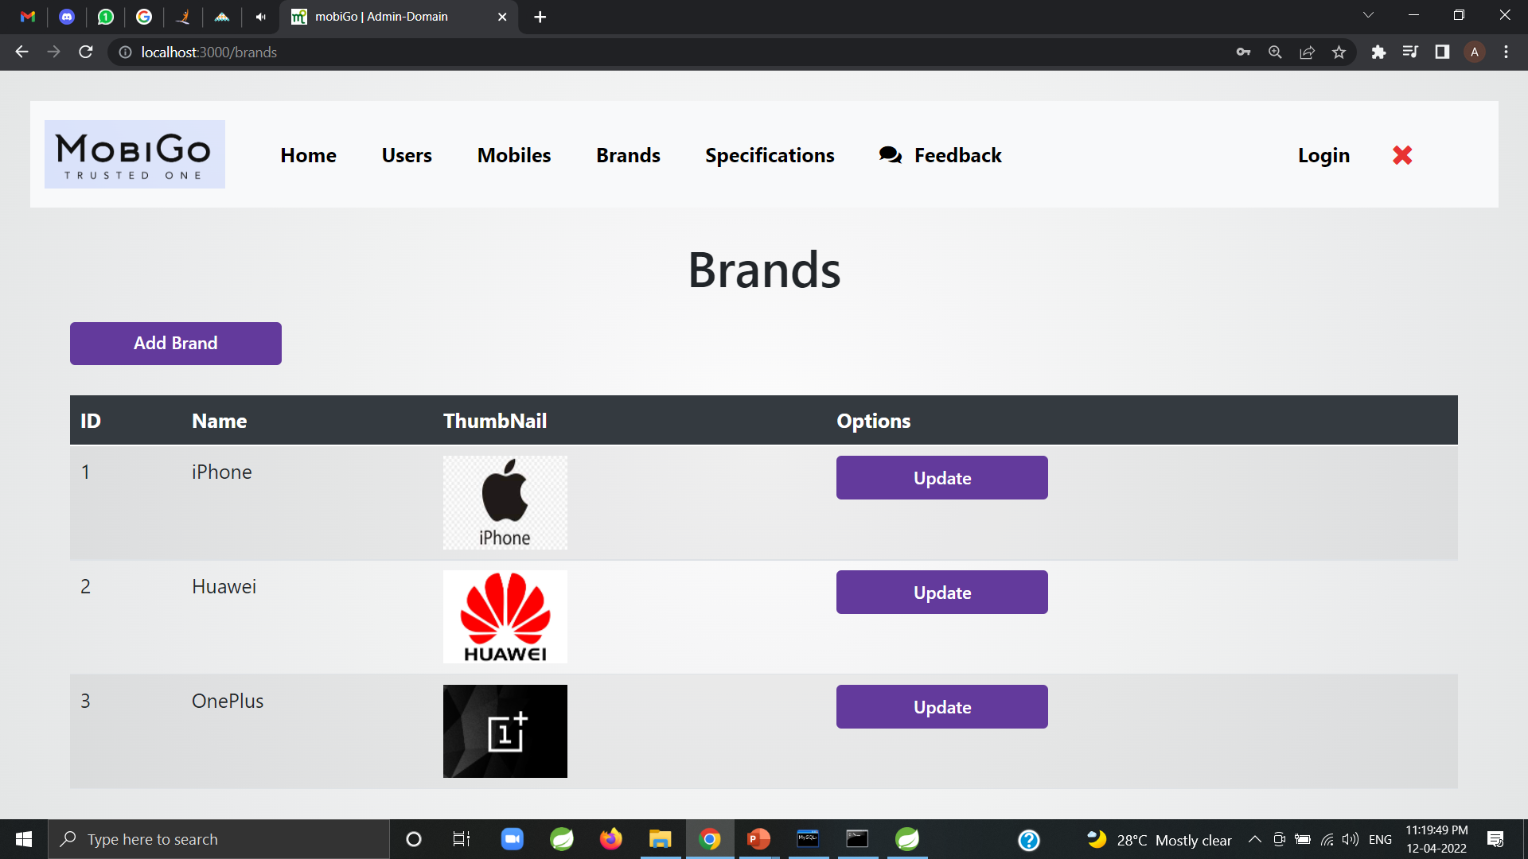
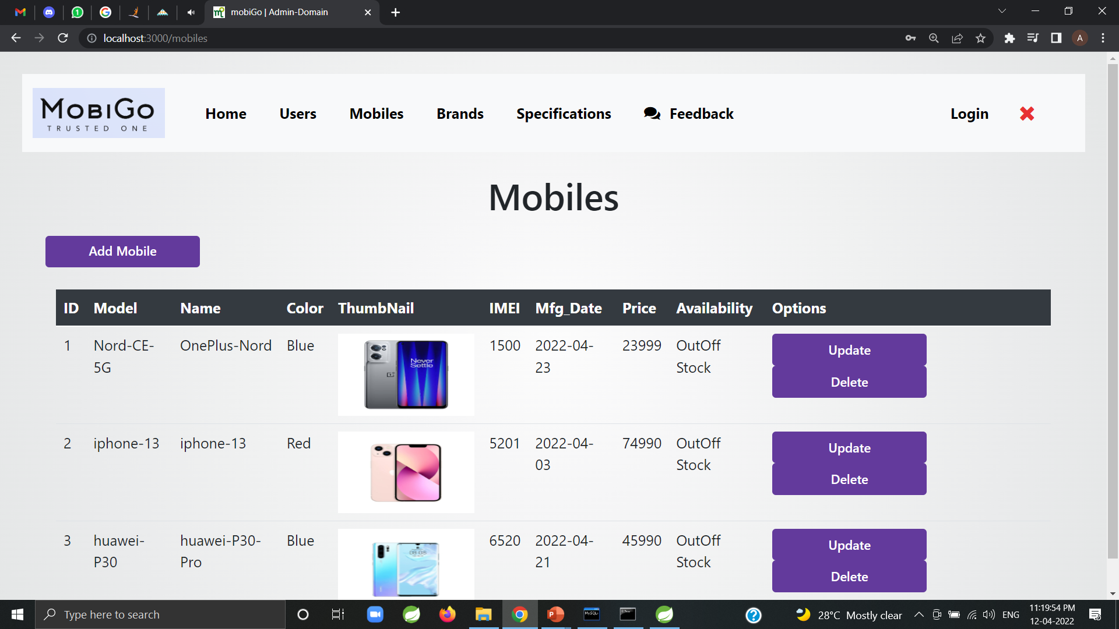

Slide 16
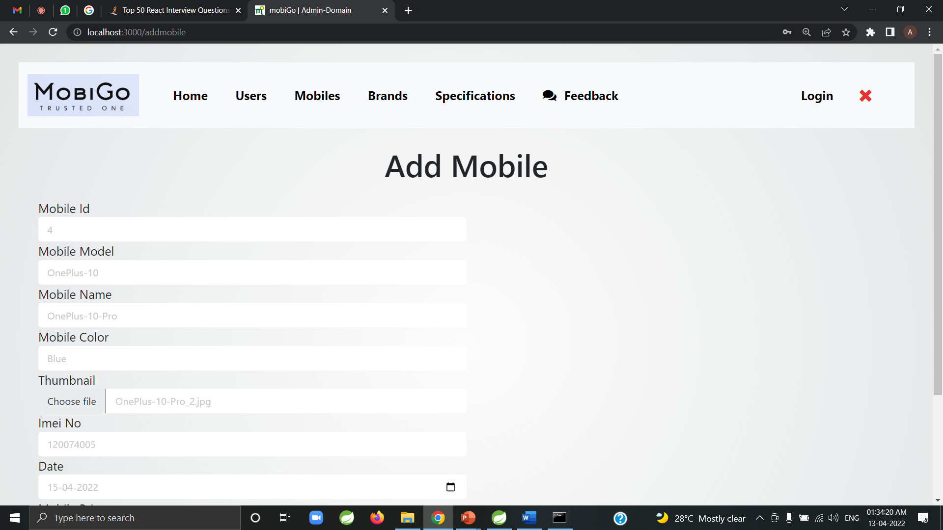
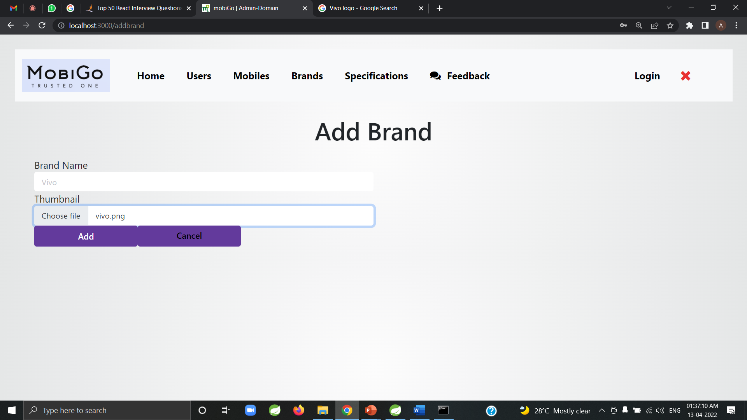
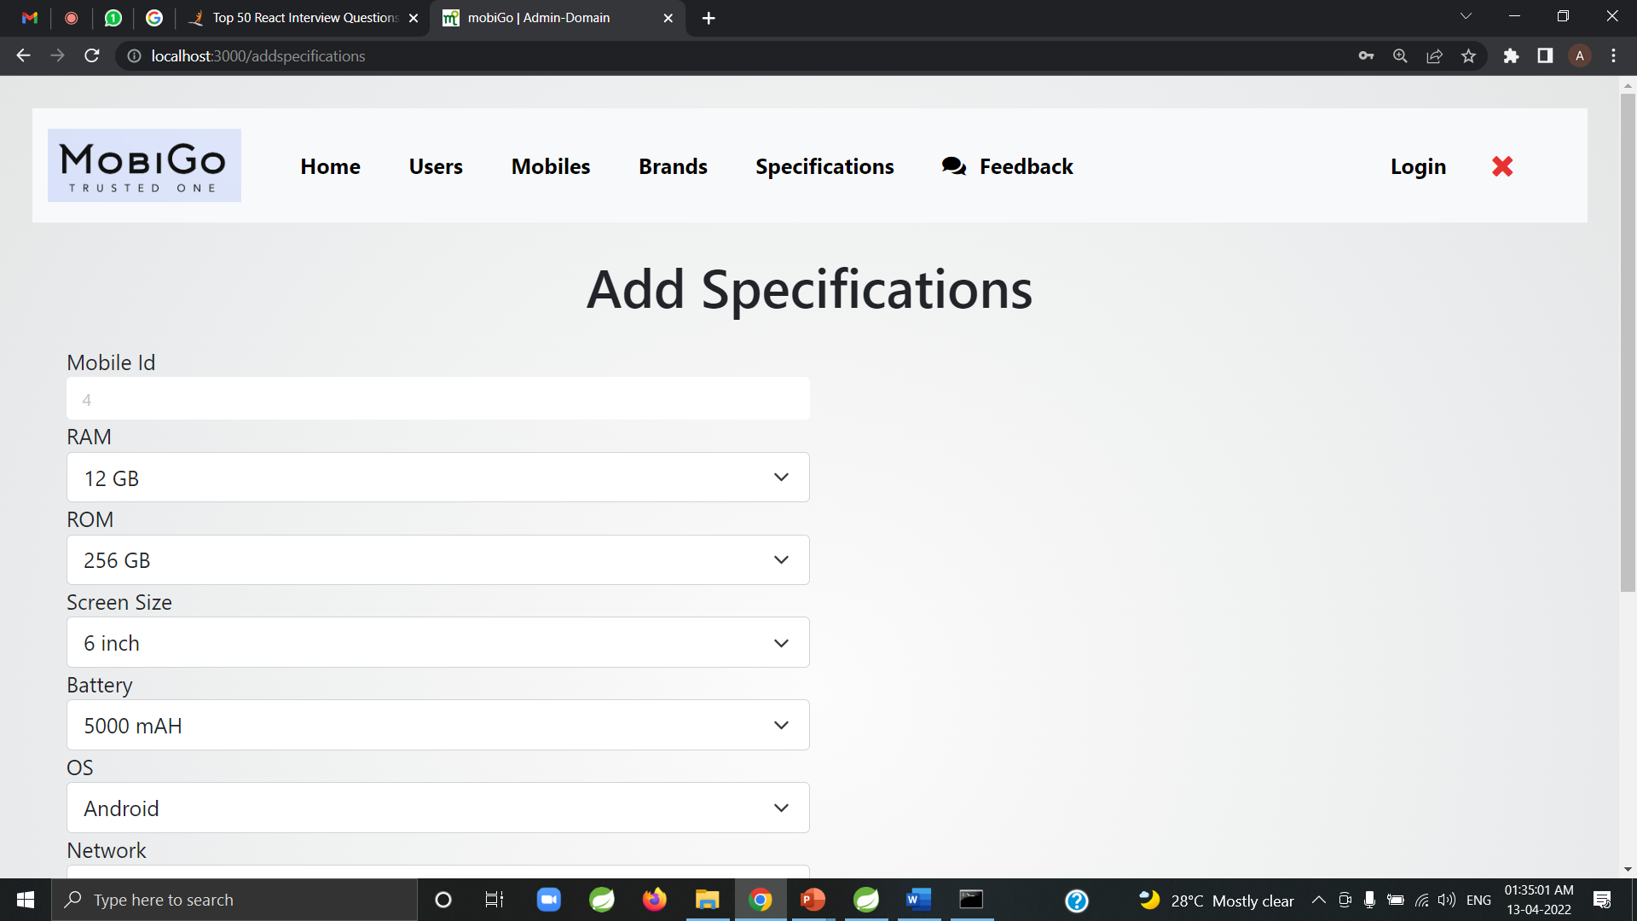
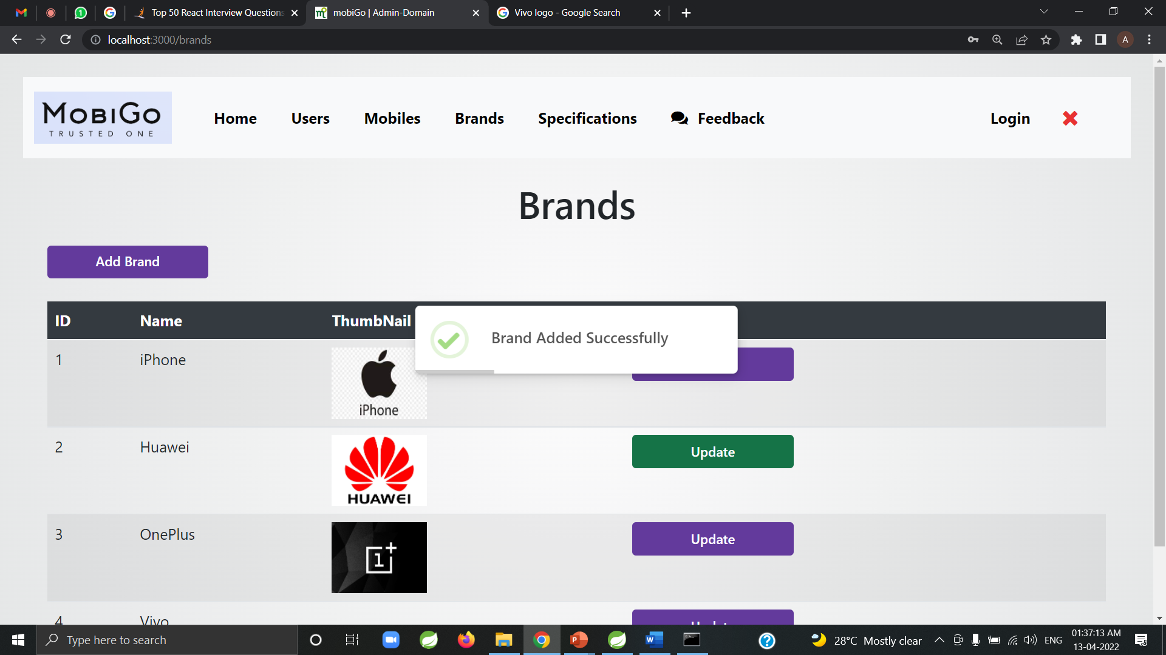

Slide 17


Users-Side

Slide 18
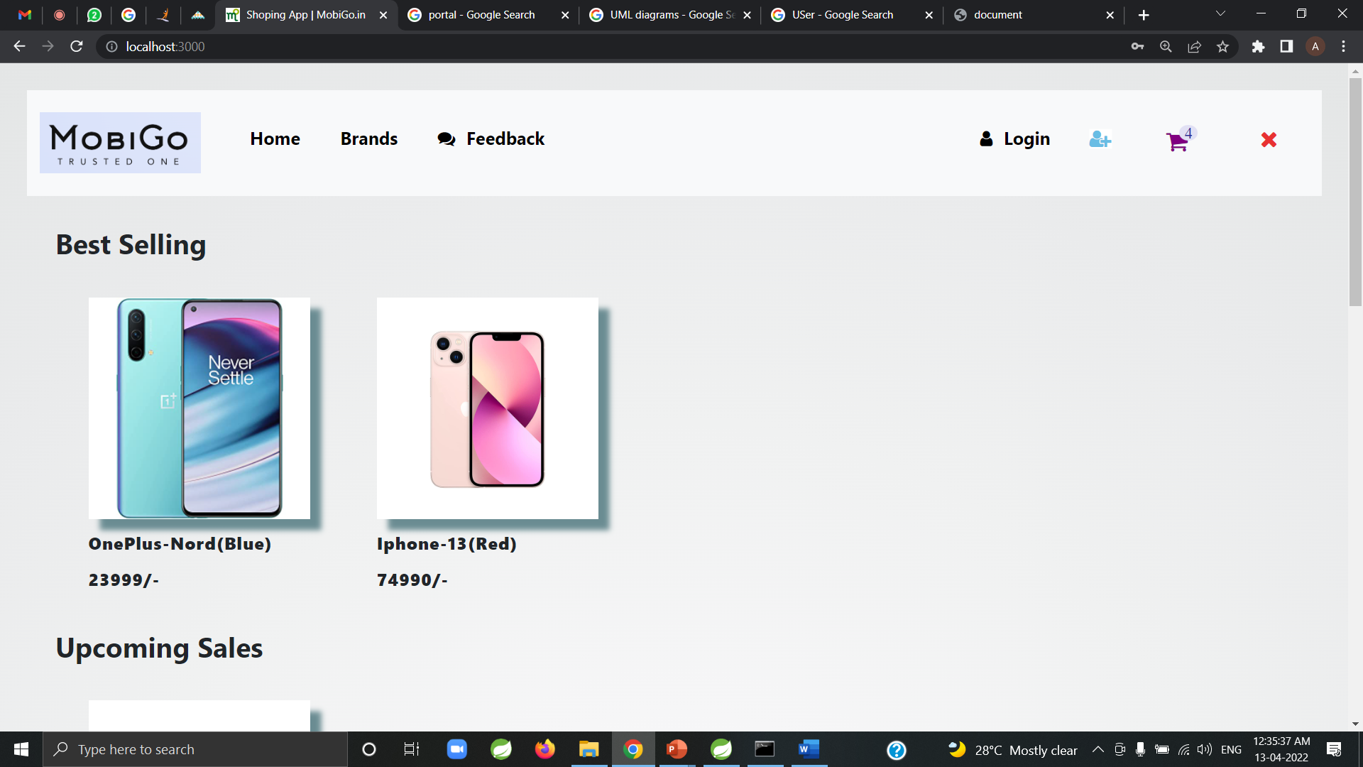

Slide 19
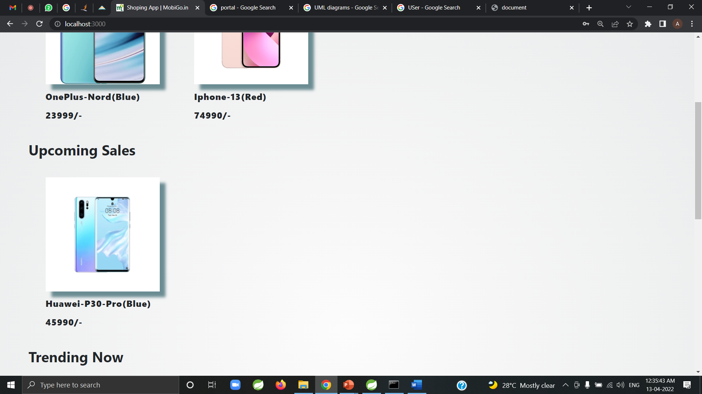

Slide 21
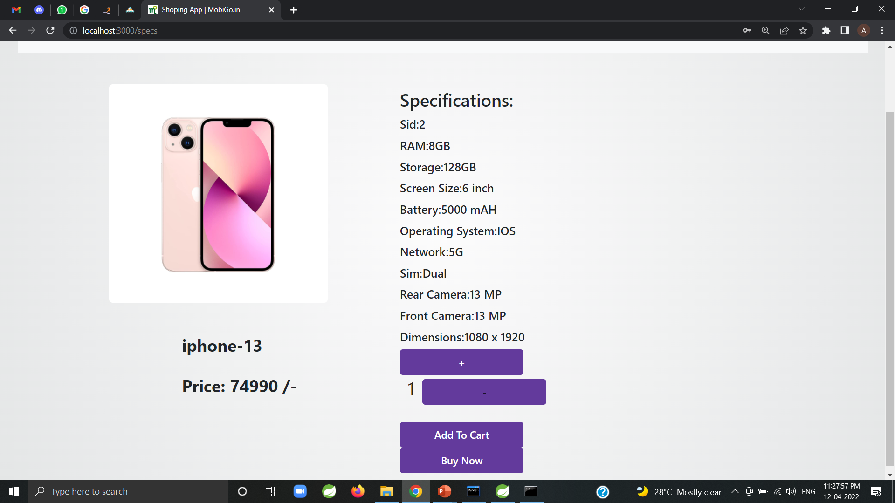
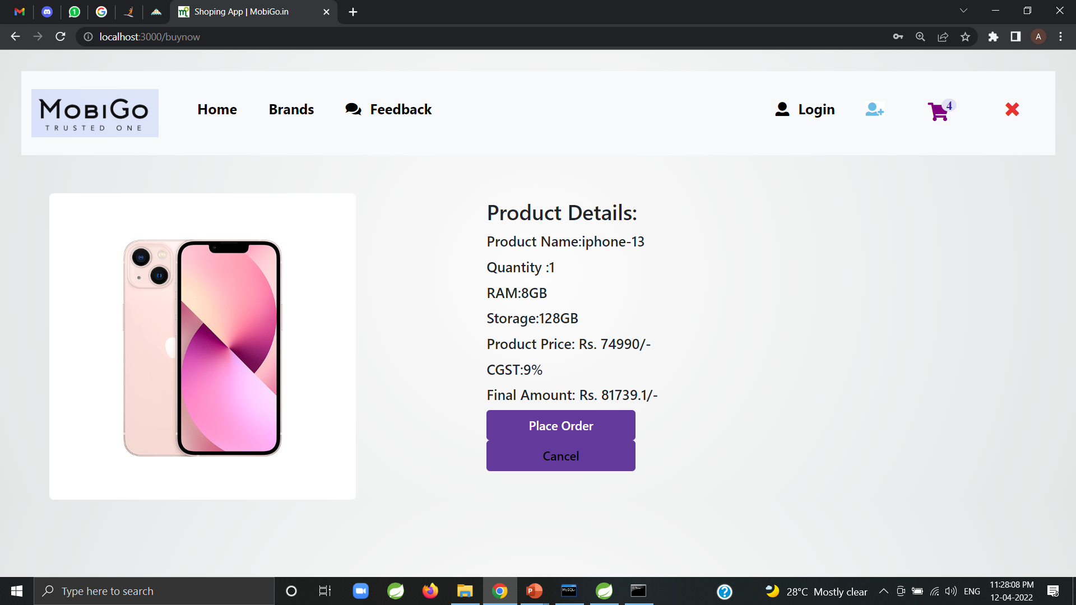
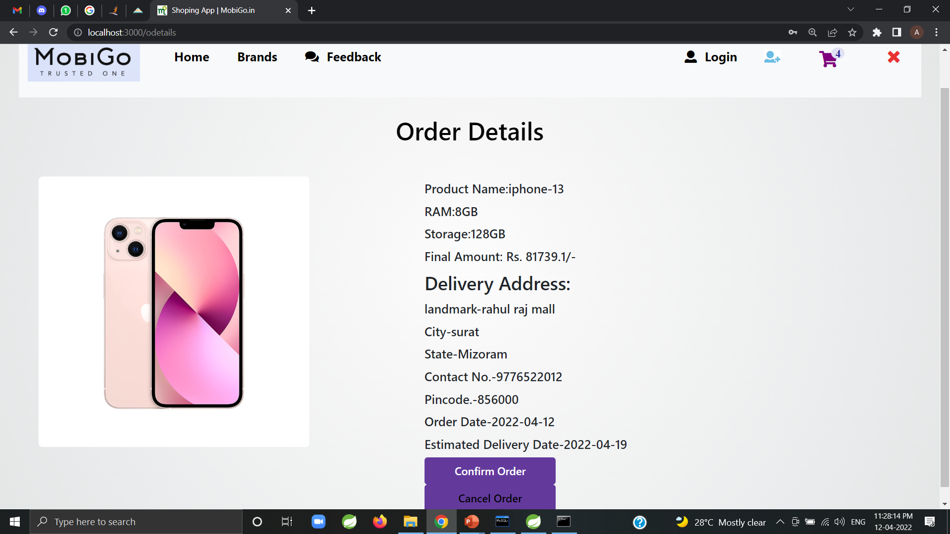

Slide 22
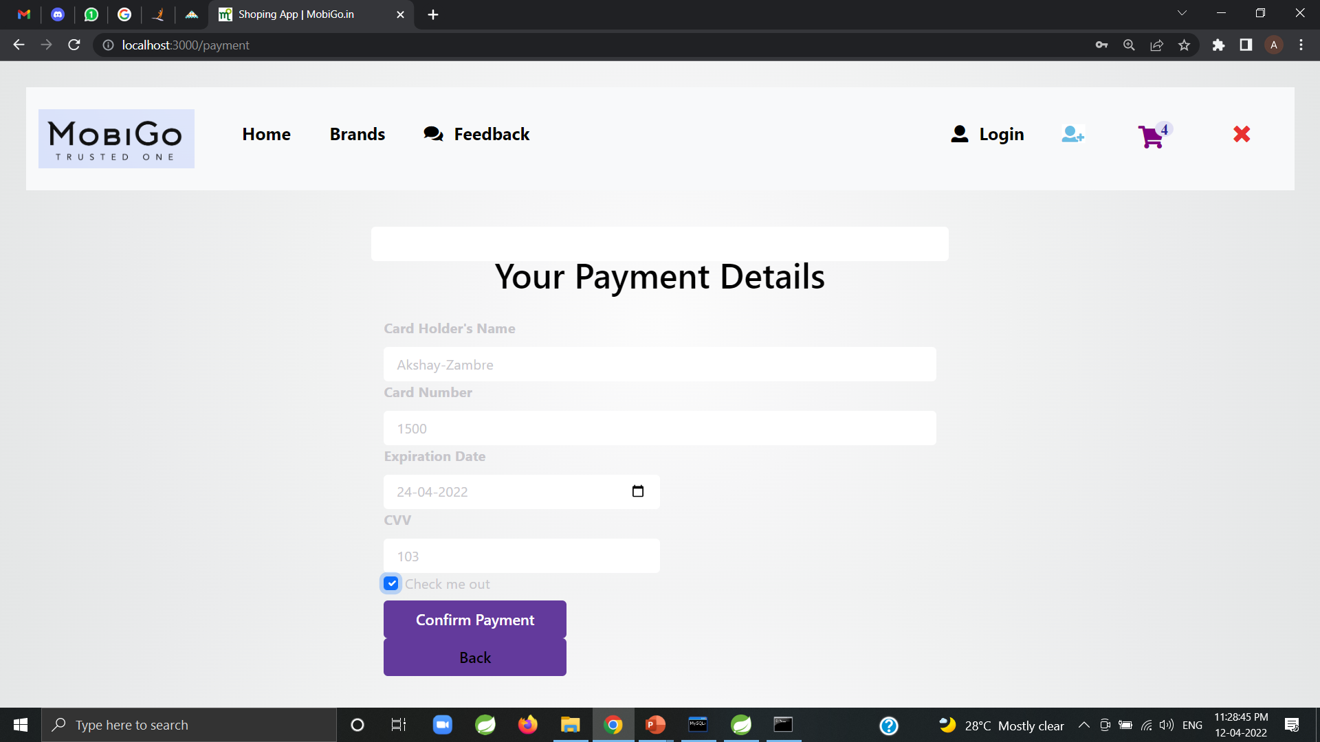
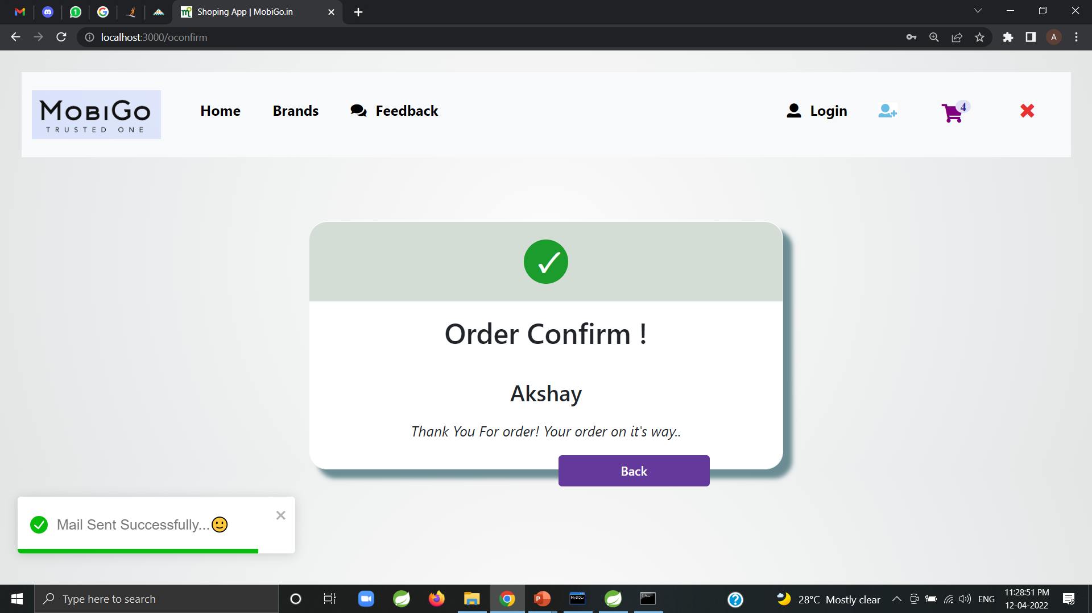
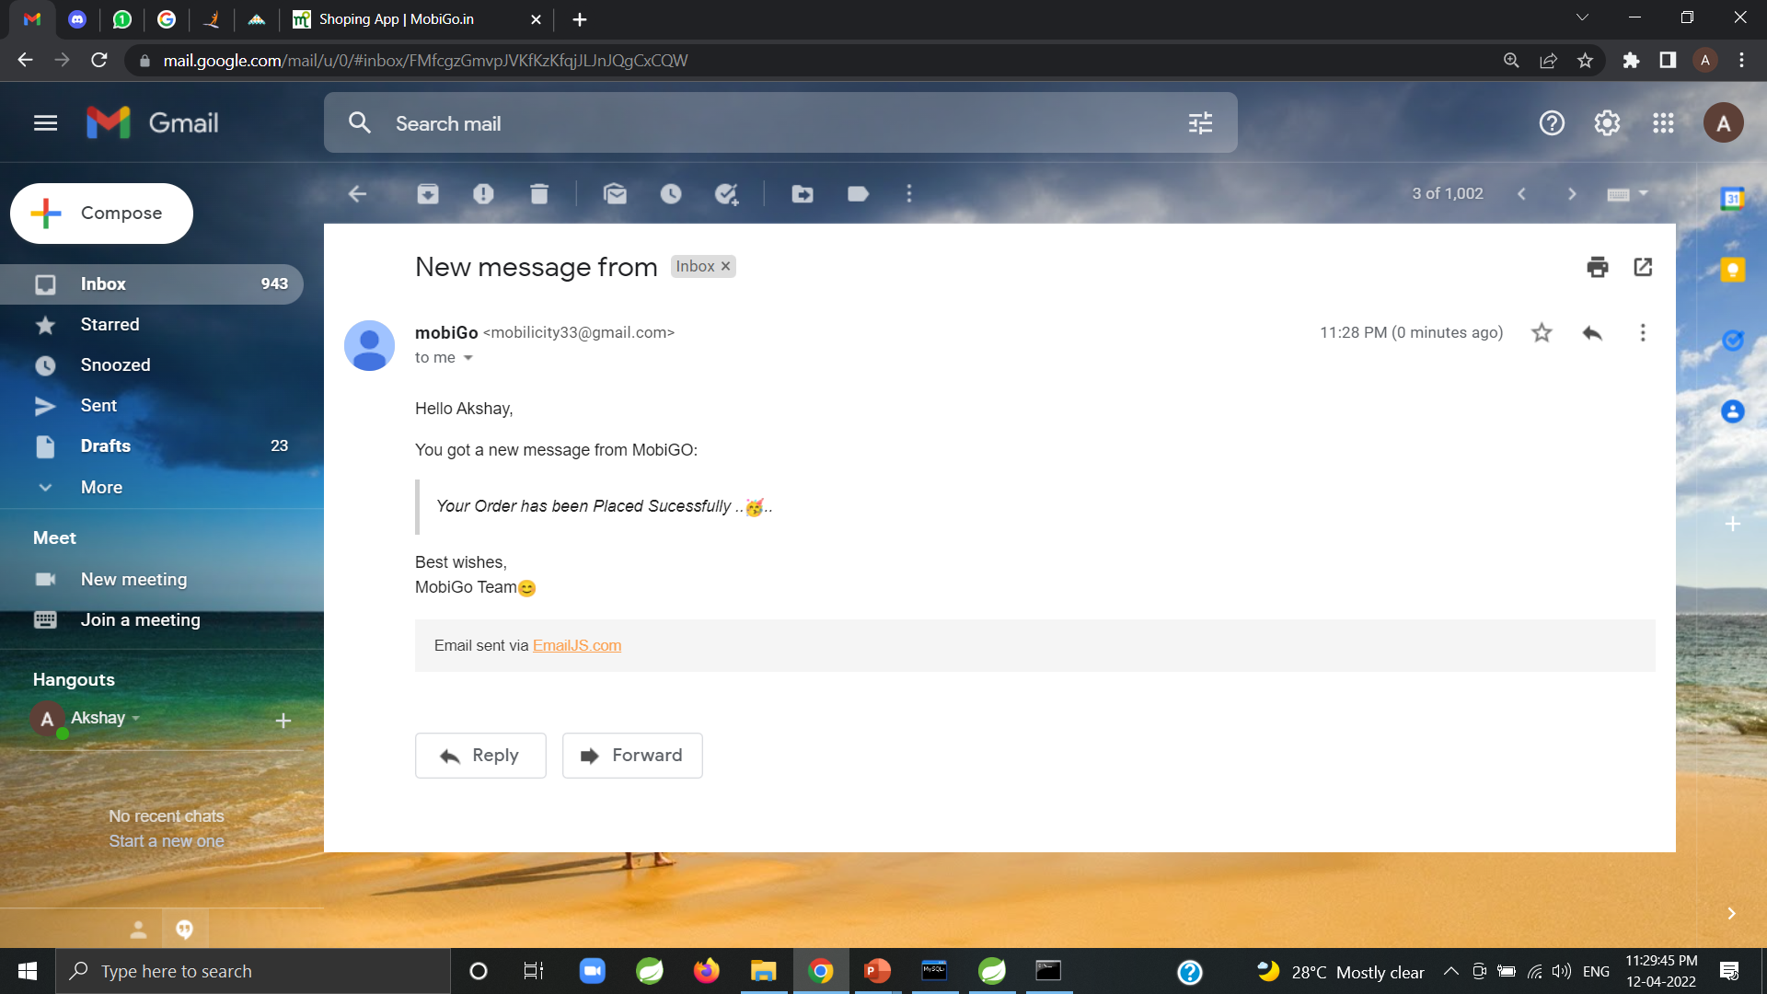

Slide 23

S/W and H/W Requirements
Server Side:
Processor: Intel® Xeon® processor 3500 series
HDD: Minimum 500GB Disk Space
RAM: Minimum 4GB
OS: Windows 10, Linux 6
Database: MySQL
Client Side (minimum requirement):
Processor: Intel Dual Core
HDD: Minimum 80GB Disk Space
RAM: Minimum 4GB
OS: Windows 7, Linux

Slide 24


Advantages
Computerized Mobile Shop System is better than the Manual Shop System.
Accuracy and Security can be maintained easily by the Admin.
It can handle all the Information about the Customer, Clients, Items and Admin.
All the information about sale, purchase will be maintain properly in this system.
All manual calculation of sale or all the money management will be performed by the computer automatically.
This system will provide timely report information.
It will produce report for sale, bill information.
The computer can hold amount of data in its storage device.
The operation and speed of the computer is very high.
We can calculate result and print any report within seconds.
Any difficulties we can solve easily.
A database application can be stored in computer effectively.

Slide 25


Conclusion
Technology has made significant progress over the years to provide consumers a better online shopping experience and will continue to do so for years to come.
With the rapid growth of products and brands, people have speculated that online shopping will overtake in-store shopping. While this has been the case in some areas, there is still demand for brick and mortar stores in market areas where the consumer feels more comfortable seeing and touching the product being bought.
However, the availability of online shopping has produced a more educated consumer that can shop around with relative ease without having to spend a large amount of time. In exchange, online shopping has opened up doors to many small retailers that would never be in business if they had to incur the high cost of owning a brick and mortar store. At the end, it has been a win-win situation for both consumer and sellers.

Slide 26

Future Enhancement
This project can enhanced further by adding Feedback system also by Adding Speed and Regular Delivery options.
The software is flexible enough to be modified and implemented as per future requirements. We have tried our Best to present this free and user–friendly website to Institutes.

Slide 27

References
1.Github
2. https://reactjs.org/community/examples.html
3. https://docs.inspireui.com/evastore/
4. https://docs.spring.io/spring-boot/docs/current/reference/htmlsingle/
ONLINE REFERENCE
https://www.slideshare.net/JayedImran1/online-shop-project-report
https://core.ac.uk/download/pdf/5165156.pdf

Slide 28

The End

